Slide 1
HTTP Based KV Server
CS744 Project
Dibyansh Gupta (25M0778)

Slide 2
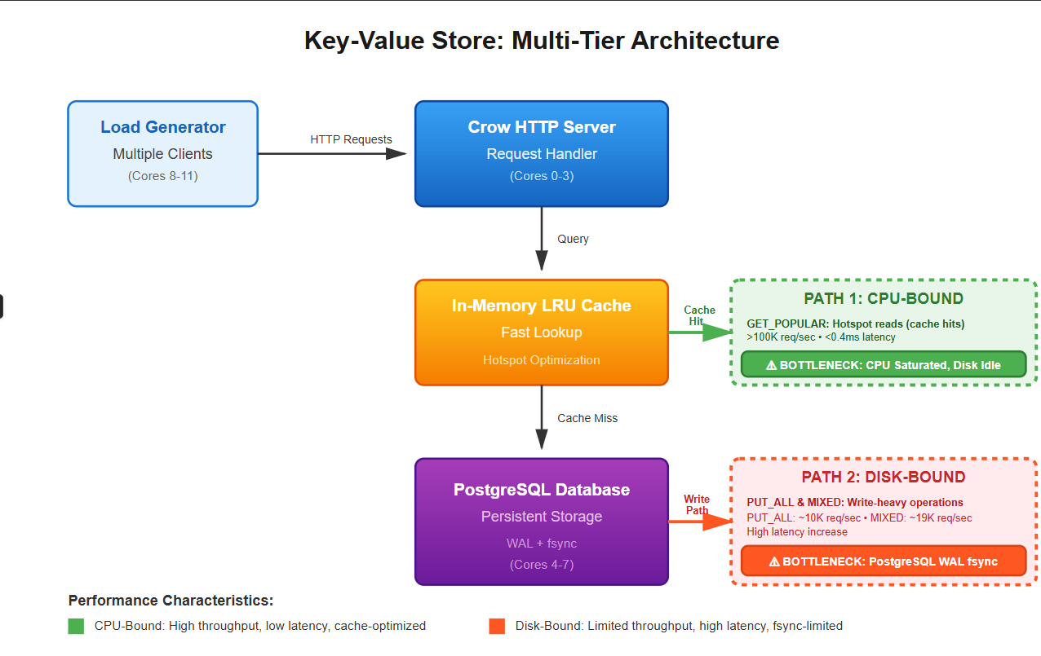
System Architecture - Multi-Tier Design
Load Generator (clients pinned to cores 8–11) — persistent TCP connections
Crow HTTP Server (server pinned to cores 0–3) — multi-threaded request handling
In-memory LRU Cache for hotspot reads (fast path)
PostgreSQL Database (pinned to cores 4–7) — WAL fsync for durability
Two paths: GET_POPULAR (CPU-bound) and PUT_ALL/MIXED (Disk-bound)

Slide 3
Development Process & Implementation
C++17 server using Crow + libpq; custom thread-safe LRU cache
Load generator in C++ with closed-loop persistent connections
Prepared statements and thread-local DB connections
CPU pinning for isolation
Nearly 300 lines of code in sever.cpp and 250 lines of code in loadgen.cpp
GitHub Repository Link → https://github.com/DibyanshGupta/CS744-Project-

Slide 4
Load Generator Design
Closed-loop (each client waits for response) to measure latency accurately
Persistent keep-alive sockets; multi-threaded clients (5–50 threads)
Workloads: GET_POPULAR, GET_ALL, PUT_ALL, MIXED
Pinned loadgen to cores 8–11 to avoid interference with server

Slide 5
Experimental Setup
Server pinned: cores 0–3 | PostgreSQL pinned: cores 4–7 | Loadgen pinned: cores 8–11
Load levels tested: clients = 5,10,15,...,50
16 threads used in Server
Test duration: 10s
Metrics: Throughput (req/s), Average latency (ms), CPU & Disk utilization

Slide 6
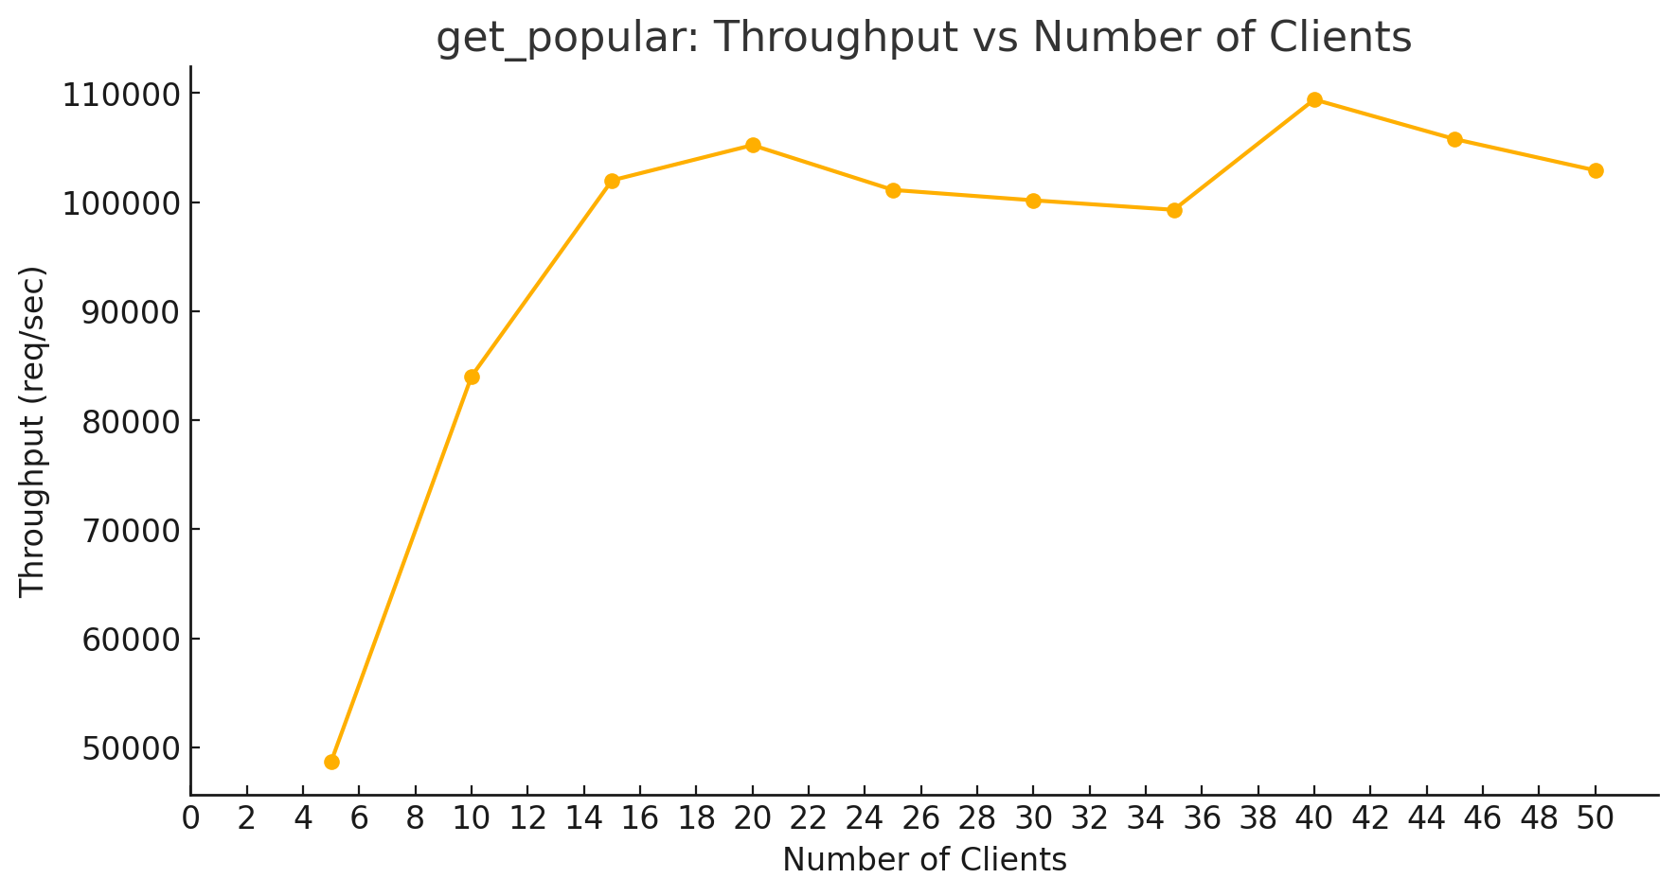
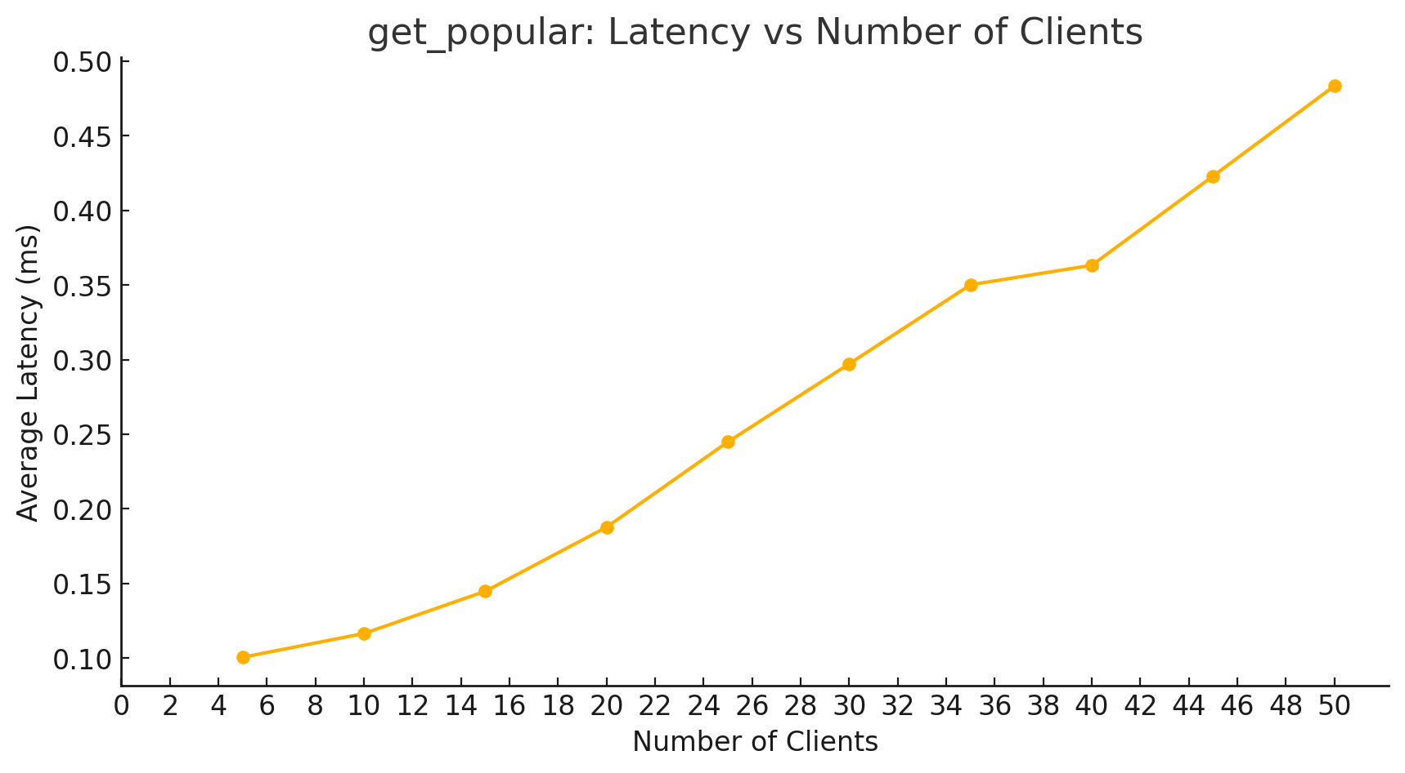
Workload #1 — GET_POPULAR (Throughput & Latency)
GET_POPULAR: Throughput vs Clients
GET_POPULAR: Latency vs Clients

Slide 7
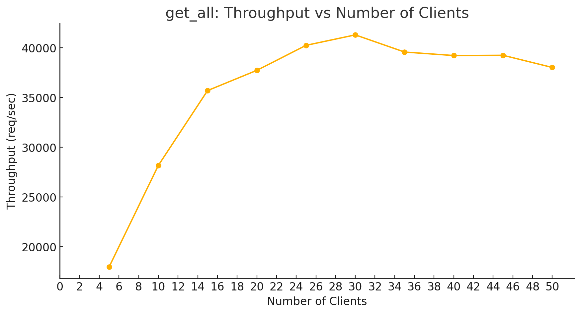
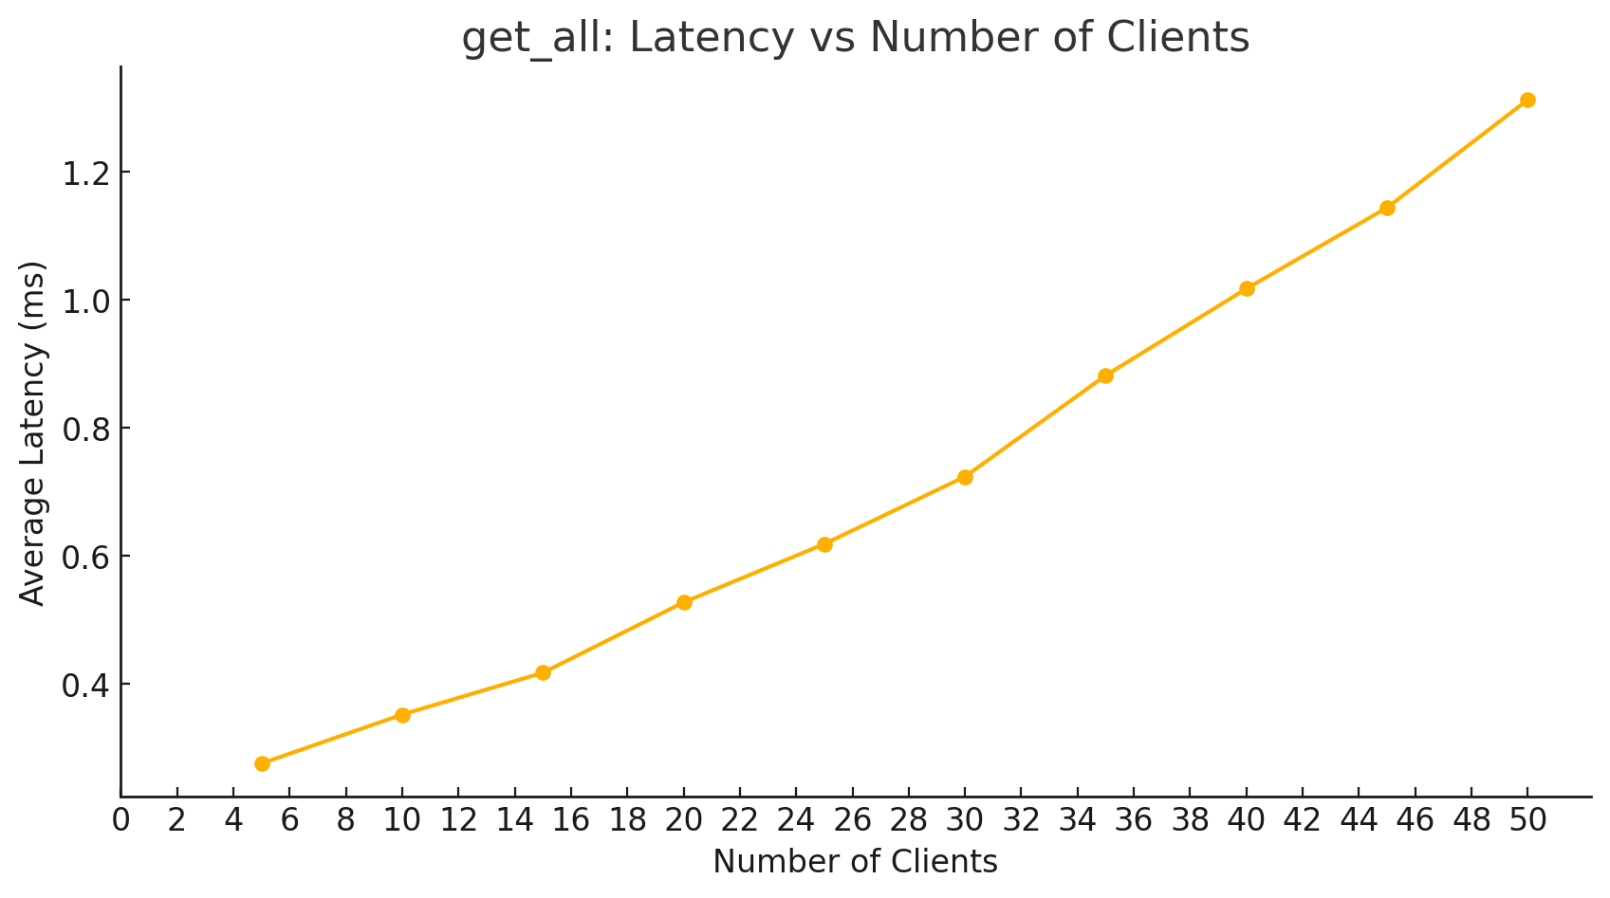
Workload #1 — GET_ALL (Throughput & Latency)
GET_ALL: Throughput vs Clients
GET_ALL: Latency vs Clients

Slide 8
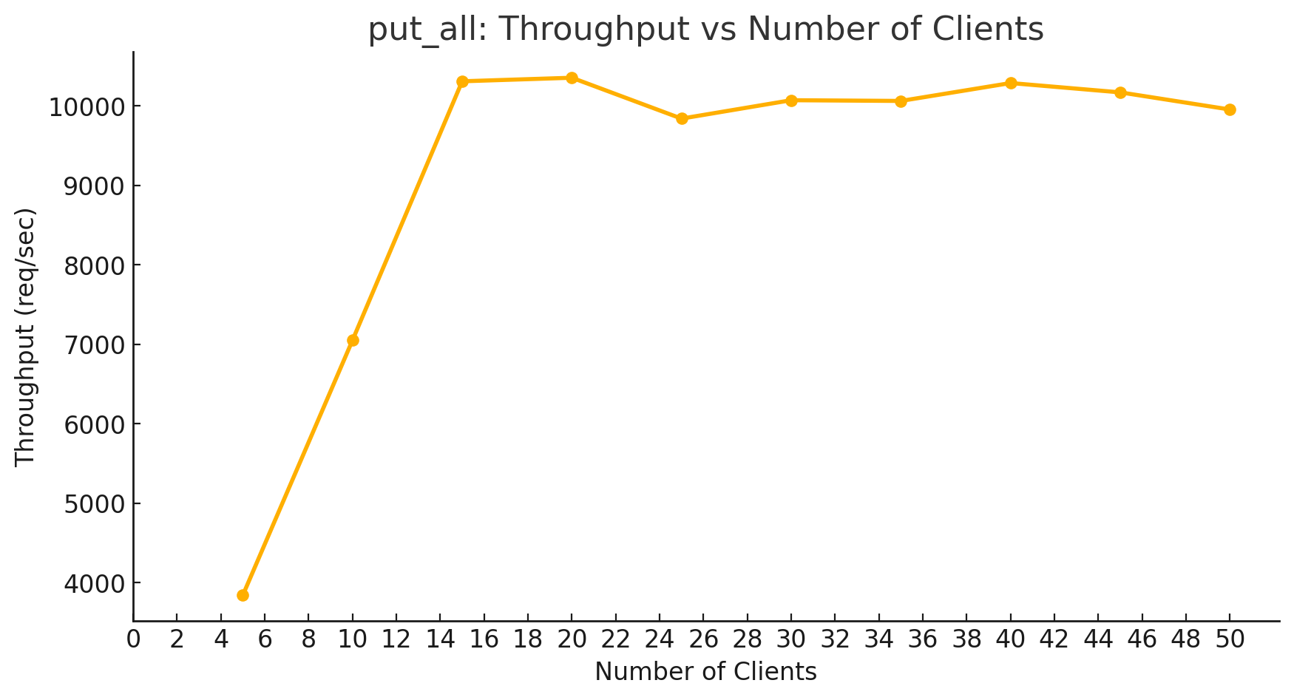
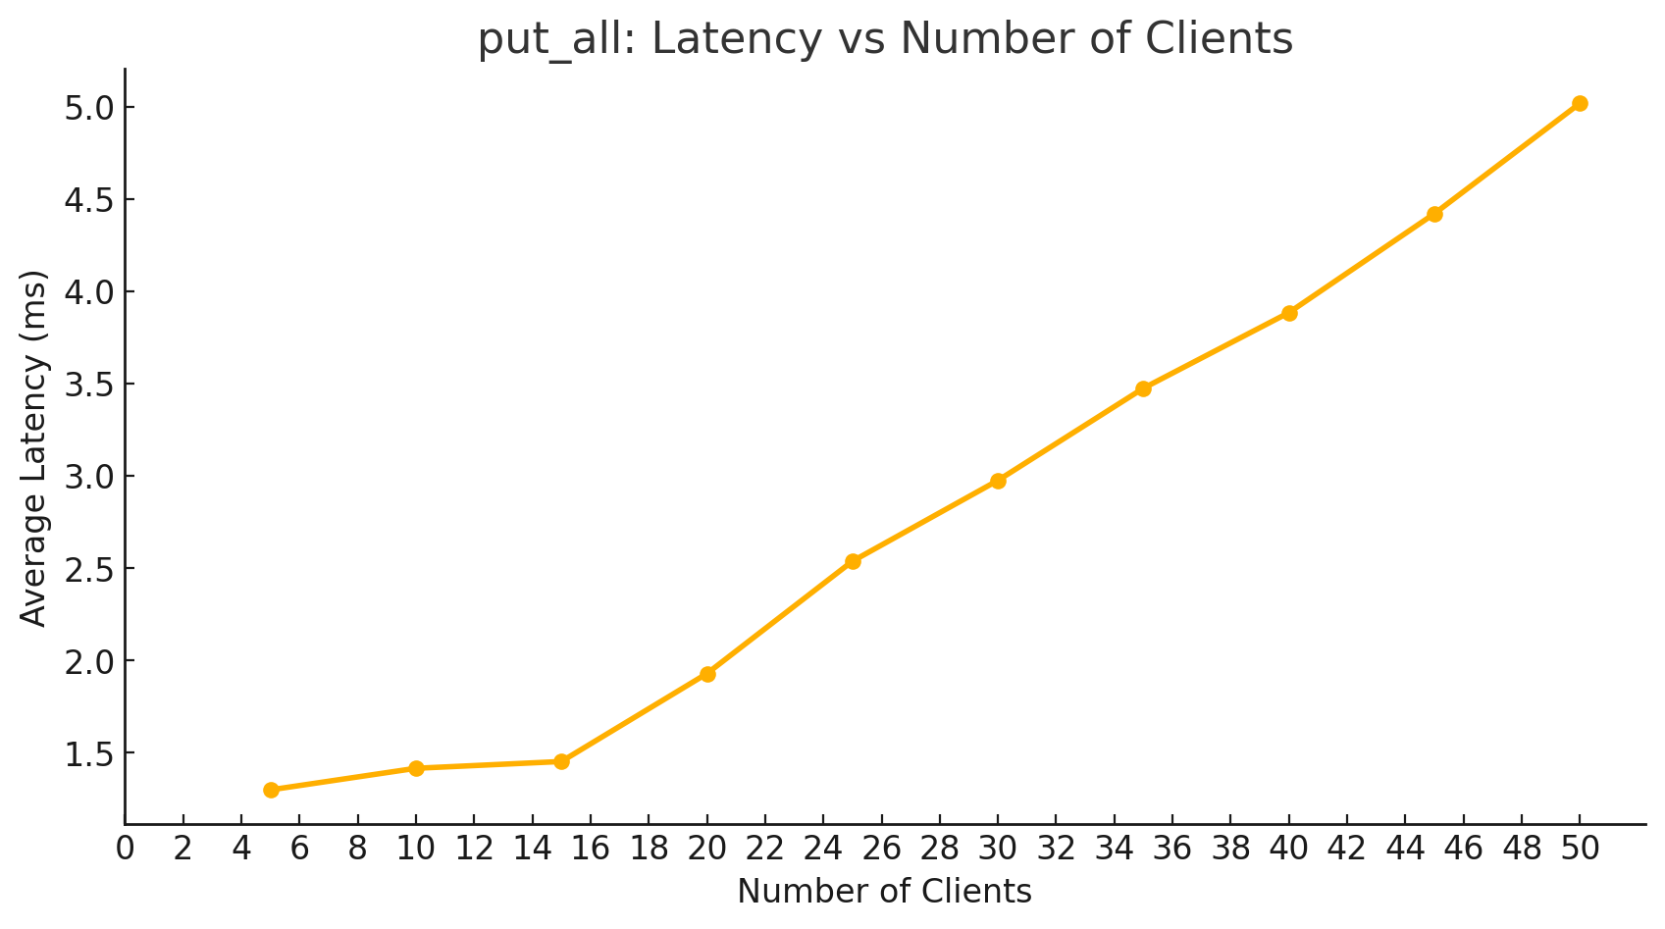
Workload #2 — PUT_ALL (Throughput & Latency)
PUT_ALL: Throughput vs Clients
PUT_ALL: Latency vs Clients

Slide 9
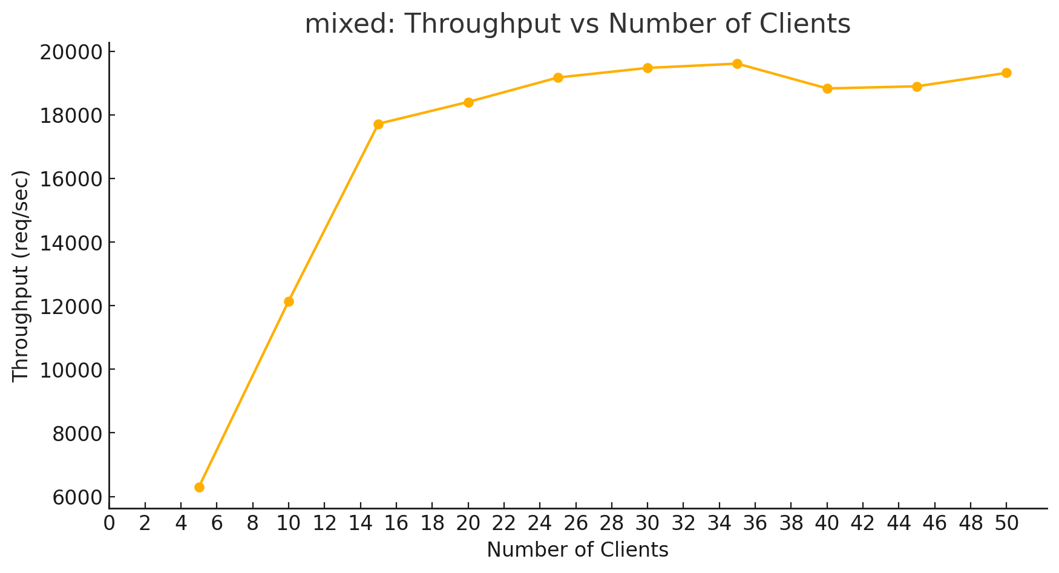
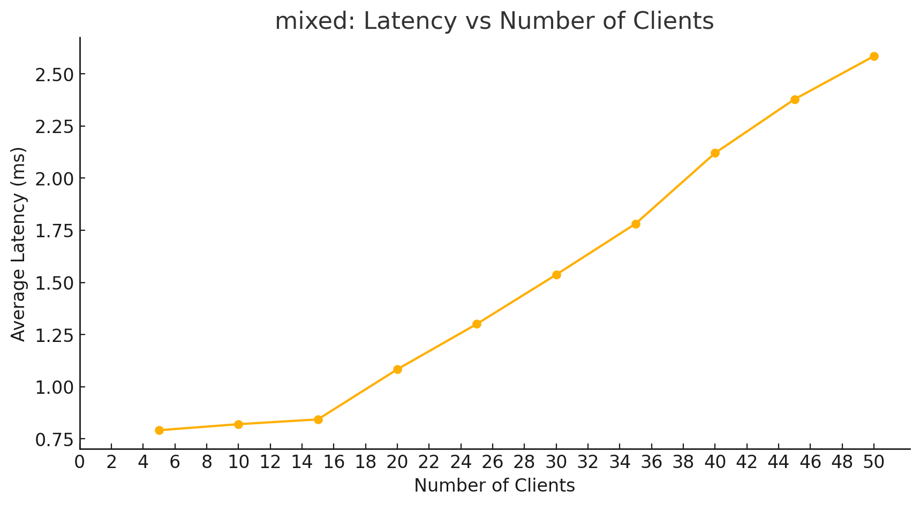
Workload #2 — MIXED (Throughput & Latency)
MIXED: Throughput vs Clients
MIXED: Latency vs Clients

Slide 10
Thank You!

